Slide 1

Patent Term Extension to drugs and new regenerative medical products in Japan
February 2015, INDIA
Kiyoshi Kuzuwa
Patent Attorney

Slide 2
Table of contents
Patent Term Extension (max. 5 yrs.) for pharmaceutical/agrochemical products
Reexamination period (4-10 yrs.) for pharmaceutical products
Law Revisions for Regenerative Medical Products

Slide 3
Table of contents
Patent Term Extension (max. 5 yrs.) for pharmaceutical/agrochemical products
Reexamination period (4-10 yrs.) for pharmaceutical products
Law Revisions for Regenerative Medical Products

Slide 4
Overview: Double track protection
Patent protection
Filing Date
Patent
Registered
Market Approval
obtained
Original
Expiry Date
Extended
Expiry Date
R&D
(6-7yrs)
Pre-clinical trial
(3-5yrs)
Clinical trial
(3-7yrs)
Examining for
Marketing approval
(9.5 mos)
Reexamination Period
(4-10 yrs)
Reexamination protection

Slide 5
What is Patent Term Extension (PTE) ?
Patents have a 20-year patent term from the date of the filing of the patent application.
The effective patent term may substantially be less than 20 years in the field of pharmaceuticals and agrochemicals due to marketing requirements in relevant laws, i.e., Pharmaceutical Affairs Act and Agricultural Chemical Control Act.
The patent term is extended to compensate patent holders for any marketing time lost due to procedures for obtaining marketing approval.
cf. SPC in Europe

Slide 6
Calculation of PTE
The extendable period of time is calculated from
  1) the day when the clinical study is started for obtaining for marketing approval (MA), or
  2) the day when the patent is registered before JPO, whichever is later,
  to one day before when MA is mailed to the applicant.
Extension is up to 5 years.
Filing Date
Registration Date
Original Expiry Date
1)
2)
Started
clinical trial
Marketing
approval

Slide 7
PTE vs. SPC
 | EU | JP
Legislative intent | to provide additional protection after expiry of patent due to a substantially shortened patent right of medicines | to compensate any marketing time loss due to procedure for obtaining regulatory approval
Which Marketing Approvals can be used? | for Medicines, Agrochemicals | for Medicines, Agrochemicals ”Medicines” do not include virus vectors and cell-sheets (such as ones used for regenerative medicine). In 2014-2015, new category of “regenerative-related medicines/medicinal devices” to be included?
Duration | Max. 5 years (additional 0.5 yr for pediatric) | Max. 5 years
When MA is given within 5 yrs. of filing patent application | No SPC given | Can still get PTE (based on calculation in previous slide)
Deadline of PTE/SPC application | -within 6 months from MA issuance, if after grant of patent -within 6 months from grant of patent, if before grant of patent | 3 months within the date of receipt of MA

Slide 8
PTE vs. SPC (cont’d)
 | EU | JP
Identity of MA holder and patent holder when applying for SPC/PTE | MA holder can be different from patent holder | MA holder has to be the same entity as patent holder or its licensee
Applicable patents | Substance patents Use patents Process for preparing substance patents | Substance patents Use patents Process for preparation substance patents Formulation patents etc.
# of patents extensible | 1 patent of one entity based on 1 approval | One entity can extend its several patents based on 1 approval (substance, use, formulation, process for preparation, etc.)
# of extension allowed | Several times for 1 patent based on different MAs (Georgetown [c-484/12] etc.) | Several times for 1 patent based on different MA or same MA with modification in part
What is extended? | All claimed (i.e., no restriction to specific use of MA product) | Based on approved market authorization (see following slides)

Slide 9
What is extended?
According to Japan Patent Law, the scope of the extended patent right for medicine (agro-chemicals) is determined by
1) active ingredients and
2) effect/efficacy
of the product.
c.f.
In order to get marketing approval (Pharmaceutical Affair’s Act), the detailed information about a drug needs to be submitted, not only active ingredients, effect/efficacy, but also formulation, dose regimen, dosage, etc.
Active ingredient | Effect/efficacy | Form | Dose | etc.
Compound A | Pain relief | Injection | 5 mg | more detail

Slide 10
What is extended?
Registration Date
Original Expiry Date
Substance Patent
“Compound A”
Any use
EP
The scope of
granted claims
Substance Patent
“Compound A”
Pain relief
1
JP
Anti-cancer
2
Patent term
[Patented Claim 1] Compound A
Marketing approval | Active ingredient | Effect/efficacy
1 | Compound A | Pain relief
2 | Compound A | Anti-cancer

Slide 11
What is extended?
Registration Date
Original Expiry Date
Specific product for 1st Approval
(pain relief)
Substance patent
“compound A”
JP
The scope of
granted claims
The scope of
PTE protection
Specific product for 2nd Approval
(anti-cancer)
Patent term
A product by approval has a narrower scope since it has specific active ingredient, effect/efficacy, formulations, dosage etc.
The scope of PTE protection is broader than a product by approval because it is determined only by active ingredient and effect/efficacy.

Slide 12
Multiple Extension Possible
Registration Date
Original Expiry Date
“Compound A”
Approval 1
Patent 1
Patent 2
“A pain relief comprising compound A”
Approval 1
Patent 3
“A pain relief comprising compound A in a capsule form”
Approval 1
● Two or more patents can be extended based on a single approval.
Marketing approval | Active ingredient | Effect/efficacy | form
1 | Compound A | Pain relief | capsule

Slide 13
Examination for PTE
Registration Date
Original Expiry Date
Preceding MA (pain reliever, liquid)
The scope of
granted claims
Substance patent
“compound A”
Present MA (pain reliever, capsule)
The scope of
PTE protection
2nd PTE
Rejected
[Patented claim 1] Compound A
If 2nd MA was made for the same active ingredient and the same effect/efficacy with those for 1st MA, the scope of patent to be extended for the 2nd MA is within the first extended patent right. Thus, JPL deems that obtaining the 2nd MA is unnecessary, and PTE application based on the 2nd MA is rejected.
Marketing Approval | Active ingredient | Effect/efficacy | Form | PTE granted?
1st MA | A | Pain relief | Liquid | ○
2nd MA | A | Pain relief | Capsule | ×

Slide 14
Supreme Court decision in 2011
The PTE practice has largely been changed since the latest Supreme Court decision of April 28, 2011.
Takeda Pharmaceutical Co. Ltd. vs. JPO (Heisei-21-(Gyo-Hi)-326)
Marketing Approval | Active ingredient | Effect/efficacy | Form
Preceding MA | A | Pain relief | Liquid
Takeda’s MA | A | Pain relief | Capsule
JPO rejected Takeda’s PTE application based on Takeda’s Approval, because the existing Approval of other company was made for the same active ingredient and the same effect/efficacy.
→In response, Takeda filed a lawsuit against JPO’s decision.

Slide 15
Supreme Court decision in 2011
Takeda’s patented claim
[Claim 1] Pain relief agent comprising compound A in a capsule form
Filing Date
Registration Date
Original Expiry Date
The scope of
PTE protection
The scope of
granted claims
Composition capsule with A.
Takeda’s MA (capsule)
preceding approval (liquid)
Court decision:
When rejecting PTE application due to the preceding marketing approval, the preceding marketing approval must be within “technical scope of patented invention” of the patent for which PTE is applied.

Slide 16
New PTE examination since Dec. 2011
JPO now considers
1) active ingredient,
2) effect/efficacy and
3) technical scope of patented inventions
during PTE examination if there is any preceding approval.
Marketing Approval | Active ingredient | Effect/efficacy | Form | Dose
 | Compound A | Pain relief | capsule | 5 mg
[Patented claims] Pain relief agent comprising compound A in a form of capsule

Slide 17
Examination for PTE
Example 1
[Patented claim 1] Compound A
Marketing approval | Active ingredient | Effect/efficacy | Form | PTE granted?
1st | a1 | Pain relief | Tablet | ○
2nd | a2 | Pain relief | Tablet | ○
*A includes a1 and a2.
Example 2
[Patented claim 1] Compound A
Marketing approval | Active ingredient | Effect/efficacy | Form | PTE granted?
1st | a1 | Pain relief | Tablet | ○
2nd | a1 | Cancer | Tablet | ○

Slide 18
Examination for PTE (Cont‘d)
Example 3 (Before 2011)
[Patented claim 1] A pain relief agent injection comprising compound A
Marketing approval | Active ingredient | Effect/efficacy | Form | PTE granted?
1st | a1 | Pain relief | Tablet | ×
2nd | a1 | Pain relief | Injection | ×
Example 4 (NEW, after 2011)
[Patented claim 1] A pain relief agent injection comprising compound A
Marketing approval | Active ingredient | Effect/efficacy | Form | PTE granted?
1st | a1 | Pain relief | Tablet | ×
2nd | a1 | Pain relief | Injection | ○
PTE application based on 2nd Approval is NOT rejected due to 1st Approval, since the product for 1st Approval does not fall within the technical scope of the patented invention.

Slide 19
Examination for PTE (Cont‘d)
Example 5 (NEW, after 2011)
[Patented claim 1] Pain relief agent comprising compound A and polymer B as a stabilizer
[Patented claim 2] Pain relief agent comprising compound A and polymer C as a stabilizer
Marketing approval | Active ingredient | Effect/efficacy | Form | Stabilizer | PTE granted?
1st | a1 | Pain relief | Patch | Polymer c1 | ○
2nd | a1 | Pain relief | Patch | Polymer b1 | ○
3rd | a1 | Pain relief | Tablet | Polymer c1 | ×
PTE application based on 3rd Approval is within the scope of Claim 2.
The technical scope of the product for 1st Approval is within the scope of Claim 2 of the patent, and thus, the PTE application based on 3rd Approval is rejected.

Slide 20
Examination for PTE (Cont‘d)
Filing Date
Registration Date
Original Expiry Date
Pain relief agent
A+ polymer B
Claim 1
2nd Approval (polymer b1, tablet)
The scope of
granted claims
The scope of
PTE protection
1st Approval (polymer c1, patch)
Pain relief agent
A+ polymer C
Claim 2
Patent term
3rd Approval (polymer c1, tablet)

Slide 21
Examination for PTE (Cont‘d)
Example 6 (NEW)
[Patented claim 1] Pain relief agent comprising compound A
[Patented claim 2] Pain relief agent of Claim 1, in a form of injection
Marketing approval | Active ingredient | Effect/efficacy | Form | PTE granted?
1st | a1 | Pain relief | Tablet | ○
2nd | a1 | Pain relief | Injection | ×
PTE application based on 2nd Approval is rejected because Claim 1 encompasses the product for 1st Approval.

Slide 22
Examination for PTE (Cont‘d)
Filing Date
Registration Date
Original Expiry Date
The scope of
granted claims
Claim 2
2nd Approval (injection)
Rejected
The scope of
PTE protection
Claim 1
injection
… Pain relief…
1st Approval (tablet)
Patent term
PTE application based on 2nd Approval is rejected even if the PTE based on 1st Approval has shorter time.
In this case, filing a divisional application for claim 2 might be useful.

Slide 23
Table of contents
Patent Term Extension (max. 5 yrs.) for pharmaceutical/agrochemical products
Reexamination period (4-10 yrs.) for pharmaceutical products
Law Revisions for Regenerative Medical Products

Slide 24
What is reexamination system?
Aim: Reconfirmation of clinical usefulness of drugs by collecting information on the efficacy and safety of the drug during a specified period of time after approval (=reexamination period).
During reexamination period, applicants seeking for marketing approval need to submit the same amount or more data (taking ca. 3-6 yrs of work)as the original authorization holder of the drug.
After reexamination period, applicants submit only bioequivalency test, dissolution test, stability test, etc., for getting marketing approval for generig drugs.
Reexamination system works as if it protects branded drugs from generic drugs during the reexamination period.
cf. Data exclusivity in Europe

Slide 25
Reexamination system vs. Data Exclusivity
 | EU | JP
Legislative intent | To exclude others to utilize data generated by the original developer | To reconfirm clinical usefulness of drugs for certain period of time
Duration | 8 yrs (data protection) +2 yrs (market protection) +1 yr (new indication) = 11 years | 4 to10 years (market exclusivity included)
During the duration | Others can get into market by submitting their own data | Same as data exclusivity
Protection in principle | Orphan drugs New substance | Orphan drugs New substance New indication New routes of administration New dosage

Slide 26
Reexamination Period
Types of drugs | Reexamination Period
-Orphan drug | 10 yrs. after the date of approval
-New substance | 8 yrs. after the date of approval (6 yrs. before 2007)
-New formulation (new active ingredients and/or blending ratio) -New routes of administration | 6 yrs. after the date of approval
-Known substance, but new effect/efficacy -Known substance, but new dosage/administration | 4 yrs. after the date of approval
-Already approved for orphan drugs, but new effect/efficacy/indication/dosage | 5 yrs. + 10 mos. after the date of approval
-Drugs with the same substance/ dosage/administration/effect/efficacy with the original drug | Left-over reexamination period for the original approval

Slide 27
Strategies for Generic companies
Early entry to the market is a must.
MHLW gives out market approvals in February & August within avg. 9.5 months (2012) of submitting application.
NIH price listing in June and December.
Act by third party for regulatory approval during patent term does not constitute an infringement (Supreme Court decision).
Patent term
Extension
Innovator company
Reexamination period
Feb/Aug
Jun/Dec
Marketing
approval
Generic company
Application
Marketing
approval
NIH price listing/
Start to sell

Slide 28
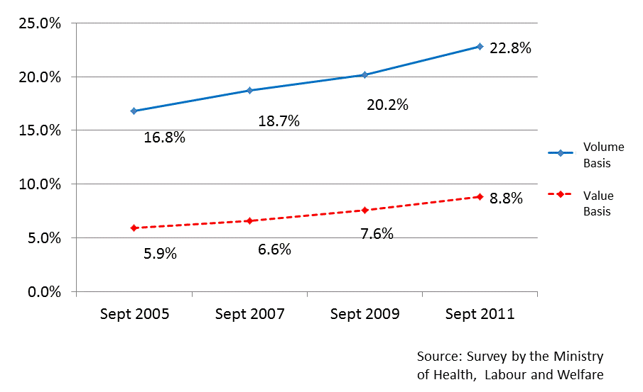
Growth of Generic Business in Japan

Slide 29
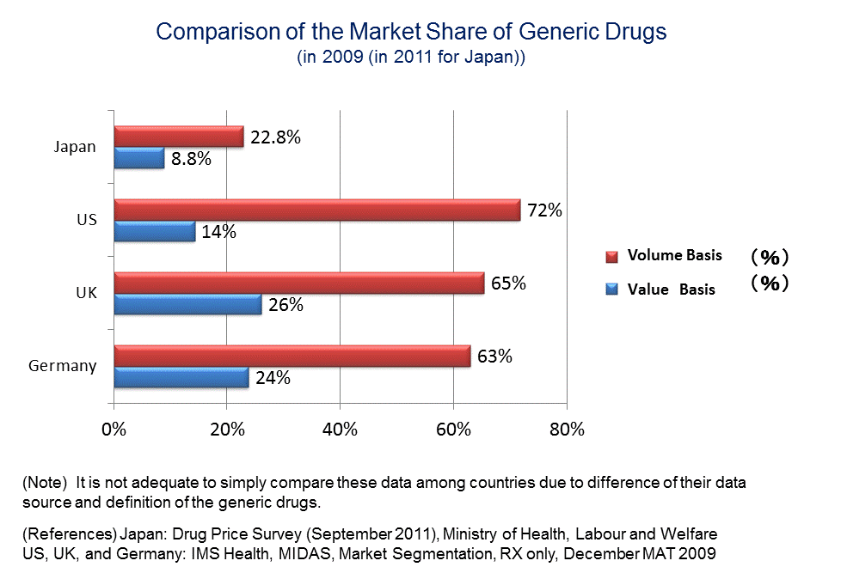

Slide 30
Table of contents
Patent Term Extension (max. 5 yrs.) for pharmaceutical/agrochemical products
Reexamination period (4-10 yrs.) for pharmaceutical products
Law Revisions for Regenerative Medical Products

Slide 31
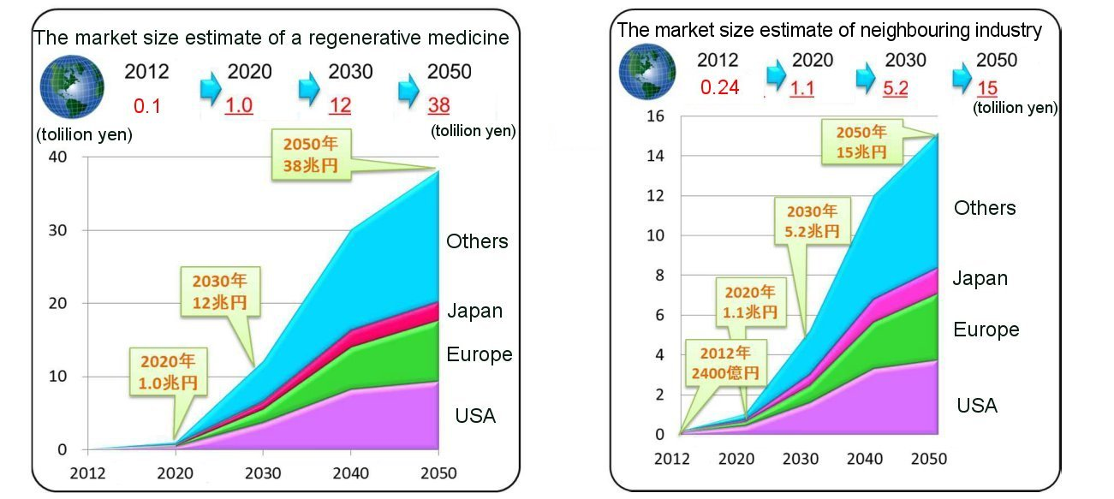
Background for Regenerative Medicine
150
420
2.8
14
60
180
1.2
12
Billion USD
Billion USD
Ministry of Economy, Trade and Industry
Notes:
Recently, regenerative medical technique is advancing day by day. Especially, establishment of the iPS cell gives a huge impact on the regenerative medical techniques and makes it put under the spotlight. Nowadays, regenerative medical technique is one of the most attention-attracting and actively-studied field in Japan.
However, there is still a big problems in ensuring safeness and practical application of the regenerative medical techniques.
Therefore, development of legal systems for the regenerative medicine is strongly required.

Slide 32
Revision of Pharmaceutical Affairs Law
        Change of name
        “Pharmaceutical Affairs Law”
        “Act on Securing Quality, Efficacy and Safety of Pharmaceuticals and Medical Devices”
        Points of the amendment are to;
        1. Strengthen safety measures regarding drugs and medical devices
        2. Revise medical device regulations based on its characteristics
        3. Introduce special regulations on Regenerative and Cellular Therapy Products (RCTP) & Gene Therapy Products (GTP)
Notes:
医薬品、医療機器等の品質、有効性及び安全性の確保等に関する法律

Slide 33
Patent Term Extension
        The patent term is extendable up to five years if the invention could not be worked due to the necessity of obtaining an approval or other disposition prescribed by Cabinet Ordinance.
        (§67II JPL)

Slide 34
        New Cabinet Ordinance for Patent Law
        Cabinet Ordinance for Patent law has been revised in accordance with the revision of Pharmaceutical Affairs Law
Before
After
Drugs
Regenerative medical product
○ PTE
Regenerative medical product
○ PTE
Drugs
Medical device
Regenerative medical product
Medical device
× PTE
Quasi-drugs
Quasi-drugs
× PTE
Cosmetics
Cosmetics

Slide 35
New Objects for PTE (Patent law)
Newly introduced Objects for PTE
◇ Cell sheet
(Cornea, Cardiac Stem Cell- Sheet)
◇ Autologous Cultured Epidermis
(Cornea, skin, cartilage)
Objects more easily applied for PTE
◇ Viral vector
Notes:
遺伝子導入医薬品（ウイルスベクター）などが、条件付承認の対象になる。
従来から当然延長登録可能だが、ウイルスベクターは中々承認を得られなかった。
今後早期に承認が得られるので、実際に延長登録されることになる。

Slide 36
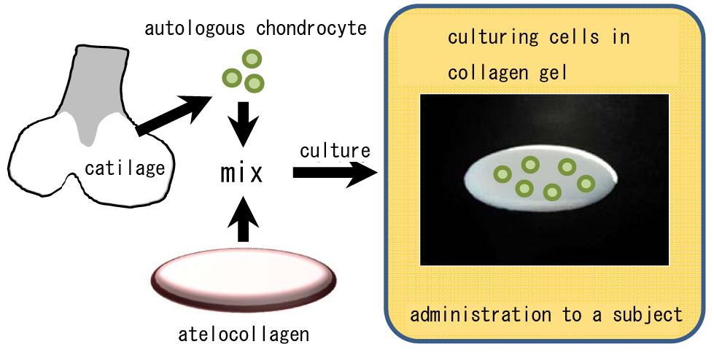
New Objects for PTE (Patent law)
        (1) Cell products which is used to regenerate a body structure

Slide 37
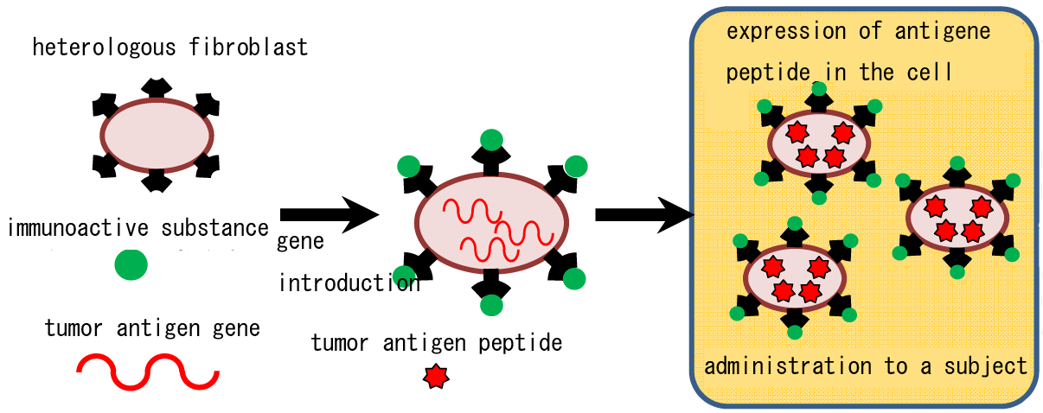
New Objects for PTE (Patent law)
        (2) Cell products which is used for the treatment of diseases

Slide 38
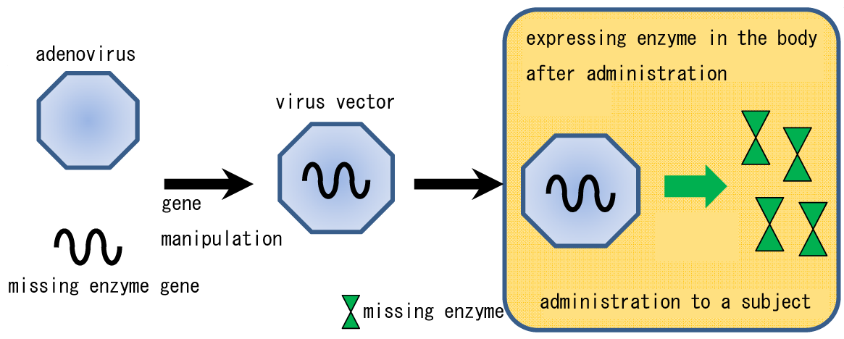
New Objects for PTE (Patent law)
        (3) Products which is introduced into the human cells for the purpose of gene therapy

Slide 39
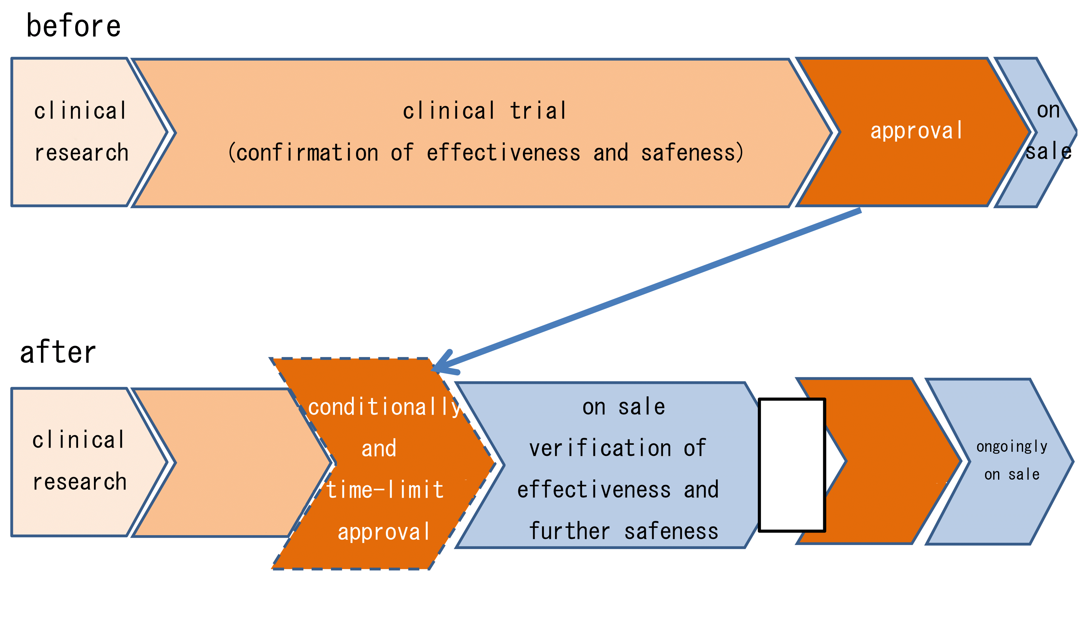
Revision of Pharmaceutical Affairs Law
        New manufacturing approval system for Regenerative Medical Products
Conventional approval system for pharmaceuticals
clinical trial
(presumption of effectiveness and confirmation of safeness)
2nd application
approval
Notes:
従来の大きな問題点：
● ヒトの細胞を用いることから品質に化合物のような均質性を求められない
● 投与する医師の技術は経験／慣れとともに上昇することが多い
⇒ ⇒ ⇒ 有効性を確認するためのデータ収集・評価に長時間を要する
従来、有効性の【確認】、安全性の確認
今回、有効性の【推定】（★患者を被験者にするが患者が少ない）、安全性の確認（★健康者を被験者にするから簡単に得られる）
患者のアクセスをより早く。
延長登録の対象となる機関は短くなるかもしれないが、投資を早く回収できる！！ベンチャー企業が多いこの業界ではうれしい！！

Slide 40
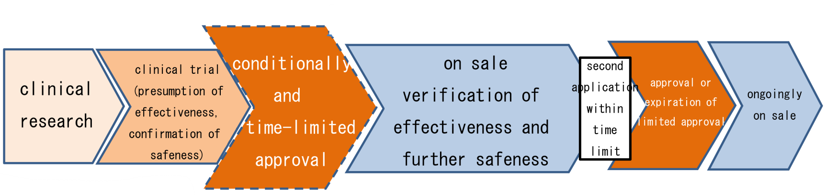
Patent Term Extension
        This approval is considered as “disposition” in§67II.
①
②
Term A
Term B
        These rules regarding PTE were executed at the same time to the execution of the Pharmaceutical and Medical Device Law on November 25, 2014.
Notes:
Term Aの理由 ワーキンググループの審議結果
①「条件及び期限付承認」も改正薬事法上の「承認」と位置付けられる
②治験開始から条件及び期限付承認までに相応の長期間が想定されている
③本承認までに特許権が満了する製品を救済する必要がある

Slide 41
Thank you!! info@kuzuwa.com

